Slide 1



Lecture 3 What's next

Slide 2
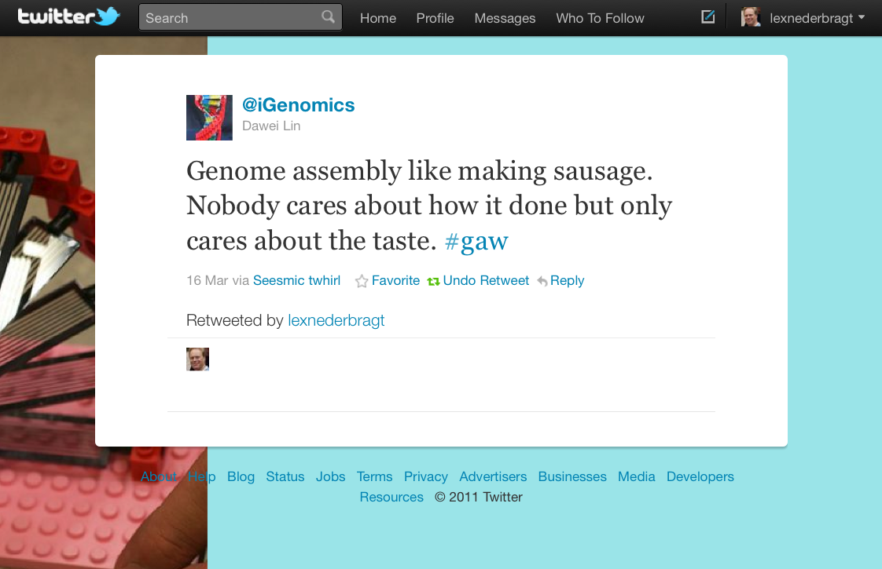

Slide 3
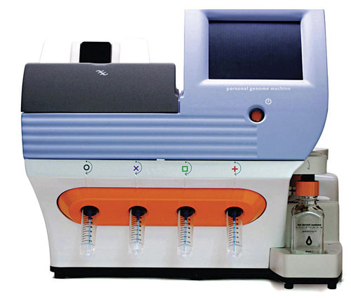
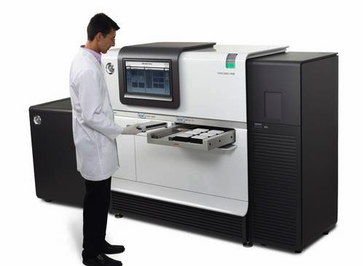
New data types
Ion Torrent
PacBio

Slide 4
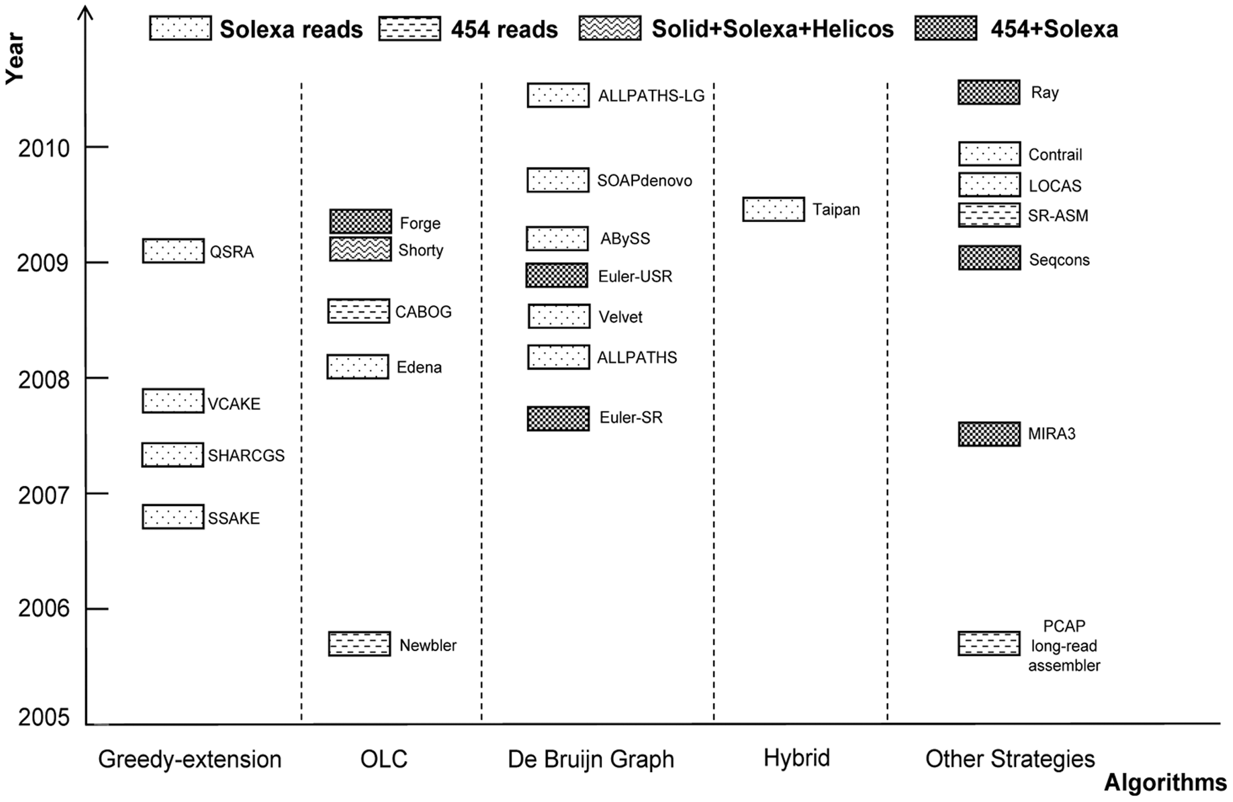
Assembly programs
Zhang et al. PLoSOne 2011

Slide 5
Assembly programs
Zhang et al. PLoSOne 2011

Slide 6

Assemblathon
Assembly competition
Eukaryotes
first one: simulated data
current one: real data
http://assemblathon.org/

Slide 7
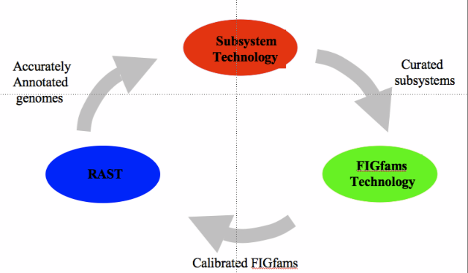
Annotation
RAST
http://www.theseed.org/

Slide 8
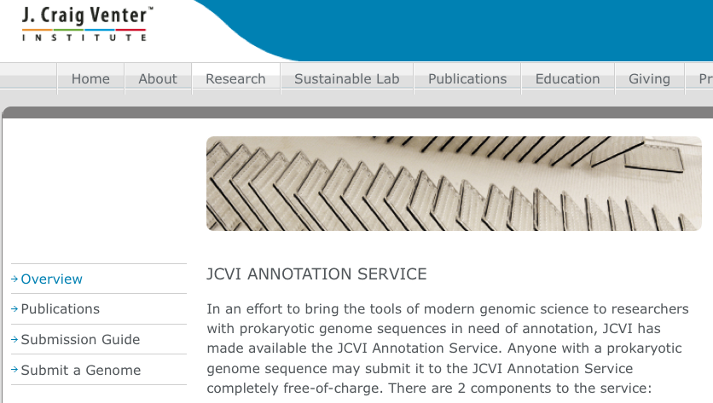
Annotation
JCVI
http://www.jcvi.org/cms/research/projects/annotation-service/

Slide 9
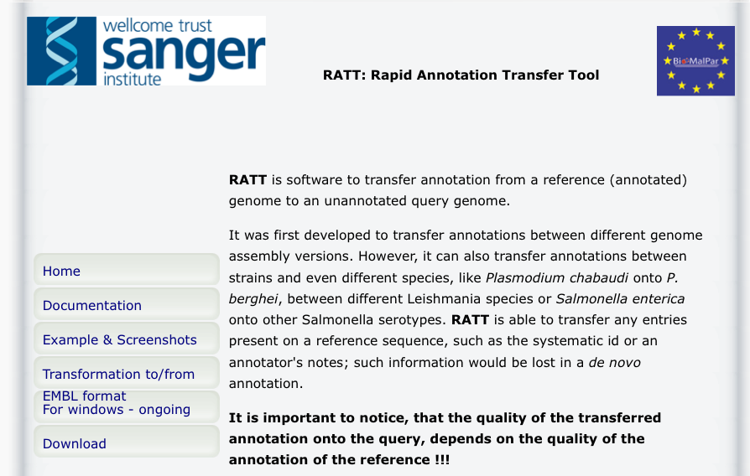
Annotation
RATT
http://ratt.sourceforge.net/

Slide 10
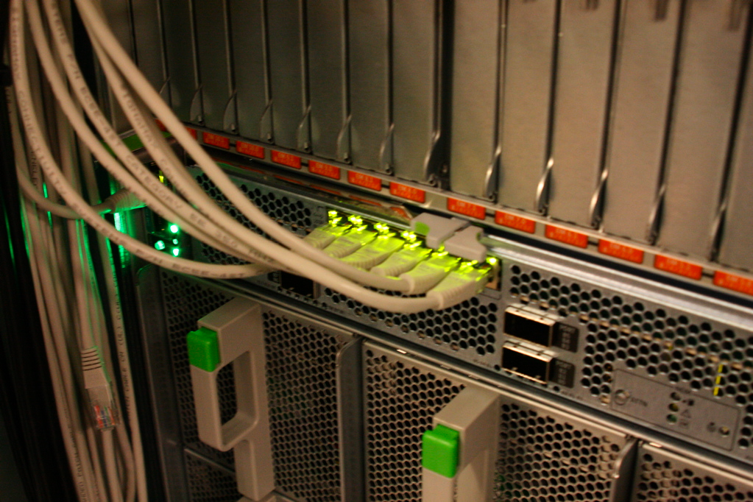
Large genomes
Challenges
Amount of data
Compute power
→ parallelization

Slide 11

Large genomes
Challenges
repeat content – can be up to 60%
heterozygosity
Check Assemblathon 2!
http://www.zazzle.com/

Slide 12
Getting started ‘at home’
Velvet
Install yourself
Newbler
Need linux
Use bioportal
Titan cluster UiO
Apply for access and resources
https://wiki.uio.no/usit/suf/vd/hpc/index.php/Getting_access

